Slide 1
Variables
Data Types
Primitive Types
Non-primitive Types
Local Variables
Choosing Data Type
Declaring
Initializing
Access Modifiers
Class (static) Variables
Instance (non-static) Variables
Notes:
Time: 5

Slide 2
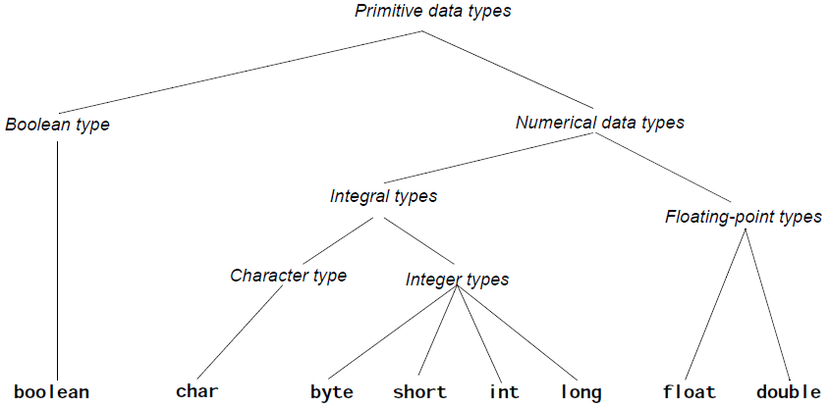
Primitive Data Types
Notes:
Time: 5

Slide 3
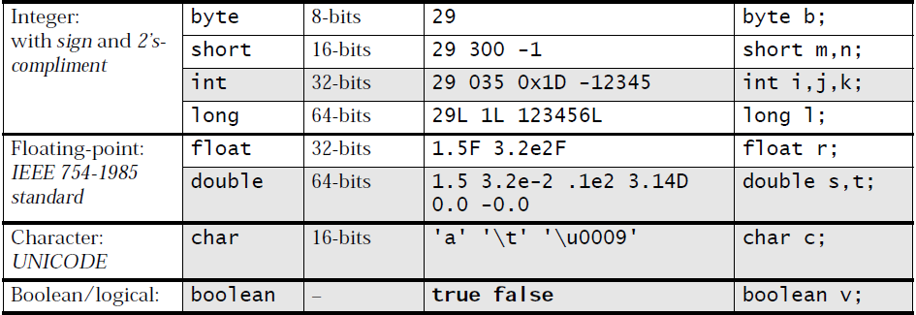
Primitive Data Types
Implicit Conversion between Primitive Types
 | byte | short | int | char | long | float | double
byte | Yes | Yes | Yes | No | Yes | Yes | Yes
short | No | Yes | Yes | No | Yes | Yes | Yes
int | No | No | Yes | No | Yes | Yes | Yes
char | No | No | Yes | Yes | Yes | Yes | Yes
long | No | No | No | No | Yes | Yes | Yes
float | No | No | No | No | No | Yes | Yes
double | No | No | No | No | No | No | Yes
Notes:
Time: 10

Slide 4
Non-Primitive Data Types
User-created
Nullable
Also called “Reference Types”
Examples:
Arrays
Lists
Files
Notes:
Time: 15
- A reference is a key value used to look up the actual object in the memory heap (i.e. used to map to an actual pointer maintained by the JVM object-management internals)

Slide 5
Access Modifiers
Access Modifiers
Public
Private
Protected
Default
Modifier | Class | Child-Class | Sub-Class | Project
Public | Yes | Yes | Yes | Yes
Protected | Yes | Yes | Yes | No
Default | Yes | Yes | No | No
Private | Yes | No | No | No
Notes:
Time: 15m

Slide 6
Static/Non-static Variables
Class (static) Variables
Instance (non-static) Variables
Accessibility | Static | Non-static
Static | YES | NO
Non-static | YES | !
Notes:
Time: 20m

Slide 7
Statements
Initialize
Assignments
Mathematical Expressions
Control Statements
Conditions: if – else, switch
Loops: for, while
Special Control Statements: break, continue, return, try-catch-finally
Notes:
Time: 5

Slide 8
Initializing
Declaration
Type and Name
Definition
Assign value to a primitive type
Instantiation
“new” Keyword
Initialization
Assign values
Constants
Notes:
Time: 20

Slide 9
Assignments
Assigning constant value
Increment/Decrement
?++, ++?, +=
Assignment from Primitives
Assignment from Non-primitives
Copying References
Cloning Objects
Again.. Primitives cannot be Null
Notes:
Time: 20

Slide 10
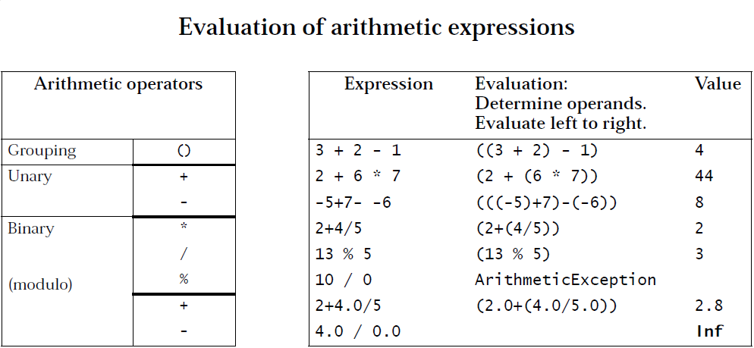
Mathematical Expressions
Avoiding Ambiguity
Evaluation
Notes:
Time: 15
- Slide 22 from “2 Basic Programming Elements.pdf”
- Challenge: Why 1.0 / 0 = Infinity and 1 / 0 is exception?

Slide 11
Operators
Logical Operators
De’ Morgan’s Law
Relational Operators
Notes:
Time: 10

Slide 12
Control Statements
Conditions
if – else
switch
Loops
for
while
Special Control Statements
break, continue
Return
try-catch-finally
Notes:
Estimated Time: 2h 30m

